Slide 1
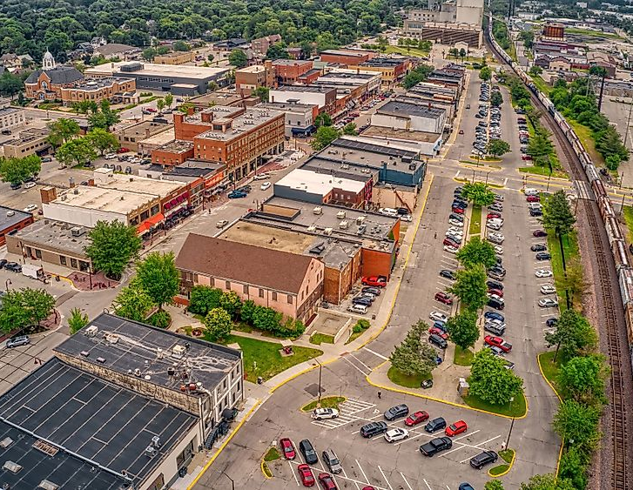
Vicki Hartley Course Project | Phase 2 Delivery 1 PPT Summary BAN-502-801-802-803-871 merged (Summer 2024)
AMES IOWA
Housing Data Analysis
Image Source https://www.worldatlas.com/cities/ames-iowa.html

Slide 2
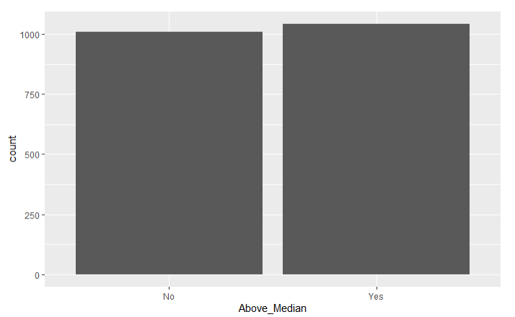
There are 2053 observations and 81 variables related to product failure including factors like:
Ames IA | Housing Data
Per the data, about half the homes sold below median and half sold above median price.
Neighborhoods
When the houses were built
Lot information
Details on the homes like BR, BSMT, Bath etc.
Sale info

Slide 3
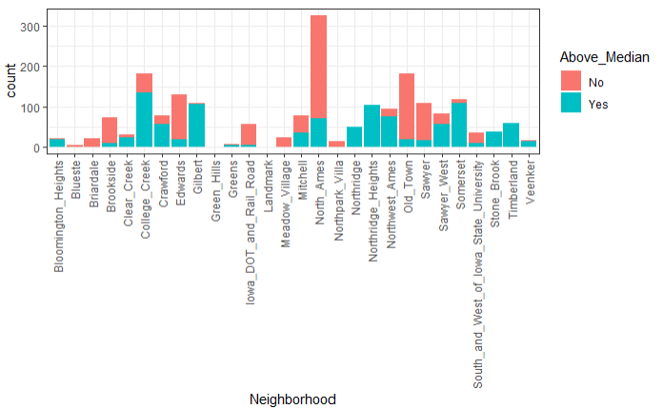
This chart shows a breakdown of houses sold above and below median by neighborhood
Ames IA | Housing Data

Slide 4
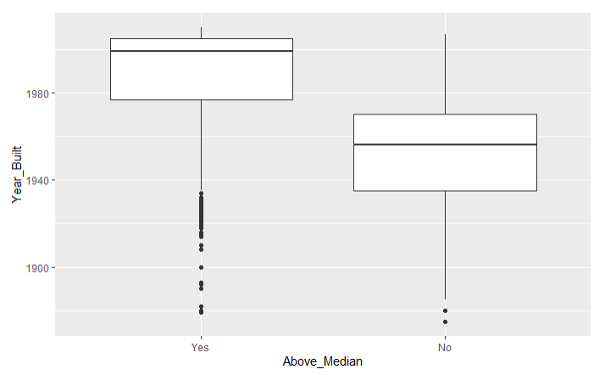
This chart shows that the age of homes could be a factor in whether it’s sold above or below median
Ames IA | Housing Data
Homes above median sale price were built after the 2000’s so newer is preferable*
Homes selling below median have an average build year of the late 1950’s
*note there is some spread in homes older than the 1940’s so there is still appeal in older homes to some buyers

Slide 5
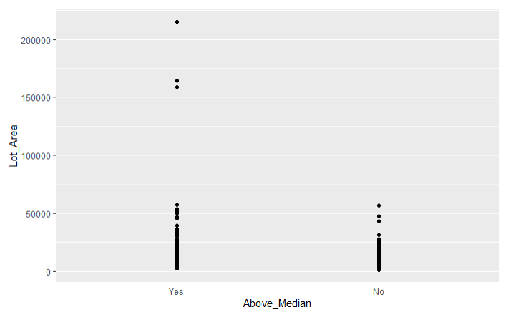
This chart highlights lot size related to whether the sale price was above or below median
Ames IA | Housing Data
Large lot sizes will skew prices to above median
Generally lot size is fairly similar in homes sold above and below median so lot size may not be a good predictor.

Slide 6
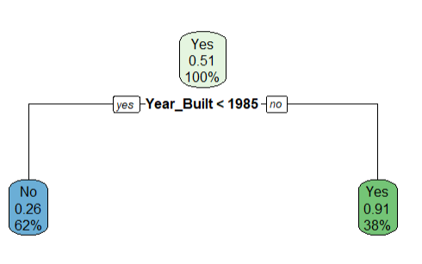
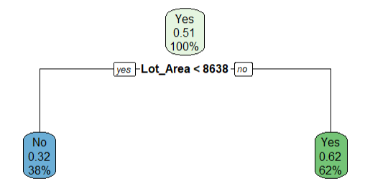
Ames IA | Housing Data
Newer than 1985
Older than 1985
As mentioned, a little over half the houses in this dataset (51%) sold above median price
26% of houses built after 1985 sold below the median price representing 62% of the data
91% of houses built after 1985 sold above the median price representing 38% of the data
32% of houses on a lot less than 8638 sold below the median price representing 38% of the data
62 % of houses on a lot larger than 8638 sold above the median price representing 62% of the data

Slide 7
Performance confirmation of accuracy in predictions
Ames IA | Housing Data
Data Set | Accuracy | Sensitivity | Specificity
Training data | 99% | 99% | 99%
Testing data | 99% | 1 | 99%

